Slide 1


SAP HANA Data Management
John Appleby
Global Head of DDM/HANA COEs
PUBLIC

Slide 2









SAP HANA Data Management Suite Secure, governed, enterprise-class applications and analytics from a trusted, unified view
Transactional Systems
S/4HANA
Intelligent Engagements
Structured Data
OLTP
ACID
3NF
Process integration
On-Premise Apps
Custom Apps
Modern UI
Machine Learning / PA
IoT / Connected Devices
Advanced analytics (text, spatial, graph, streaming)
ASE
SAP Analytics
MDW
App Dev
SAP Cloud Platform
SAP HANA
IQ
Advanced Analytics
Data Warehousing
Leonardo
Data Lakes
BW/4HANA
SQL | Schema First
OLAP & BI
EDW / Data Marts
Hierarchies
Star Schemas
Terabyte-scale
Dynamic Tiering
SAP HANA
Vora
Unstructured / Semi-structured
NoSQL | Schema on Read
Logs, Clickstreams, Sensor Readings
Petabyte-scale
EIM
Big Data Services
Data Warehouses
Notes:
SAP’s vision is to help the world run better and improve people’s lives. As SAP solutions touches 76% of the world’s transaction revenue, we have a huge impact on the world and everyone on it.
Our Strategy is to be “Be the Most Innovative Cloud Company powered by SAP HANA” is how we can solve the world’s greatest challenges. Our core strategy guiding principles enable us to drive innovation in our cloud applications and platform solutions as well deliver end-to-end customer value through a One SAP mindset.
The entire company’s strategy is being “powered by SAP HANA. It is the foundation of everything we do from applications (cloud and onpremise), analytics, Leonardo for IoT and machine learning, and general purpose data management supporting customers in an open and heterogenous environment.
SAP HANA is the heart of our Universal Data Management solution which provides the end-to-end database and data management foundation for all customers.
SAP’s modern data framework was designed for the bi-modal, universal data world and designed for the ground up to achieve the 7 Universal Data Laws
With one query, SAP’s modern data platform can deliver results from a single logical data set that covers your whole enterprise – that is Universal Data.
At it’s core is SAP HANA that has the in-memory performance (Law 1) required to handle today’s data volumes.
Our solution was designed with the freedom (Law 2) to run in the cloud, hybrid and on premise to give you the best price performance choices.
The Modern Data Framework has built-in enterprise modeling (Law 3) that can encompass your entire organizations data and processes in a single model.
SAP’s Modern Data Framework delivers independent storage and compute (Law 4) so you can scale efficiently and effectively regardless of ever changing demand.
In addition, SAP’s modern data framework has integration technology to bring together data from many sources and integrates them with the low latency (Law 5) required for real-time organizations. With this, SAP also delivers the tools to allow the data to be aggregated into the forms you need to deliver new business services and solutions.
With our EIM technology, we can cleanse, enrich and secure your data – delivering the governance (law 6) that is vital for a secure enterprise running on reliable data.
And remember, at SAP we know you have data in many places, and that data needs to be part of your universal data set, we can frictionlessly integrate (Law 7) with just about any data type from any source and leverage any remote analysis from a single platform.
SAP’s modern data framework is your framework for tomorrow.

Slide 3


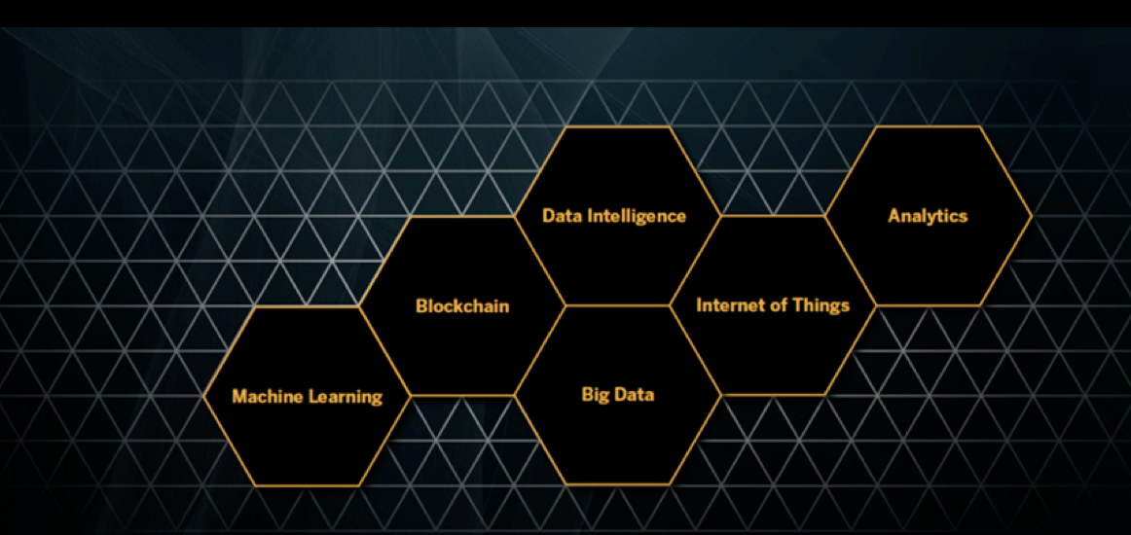
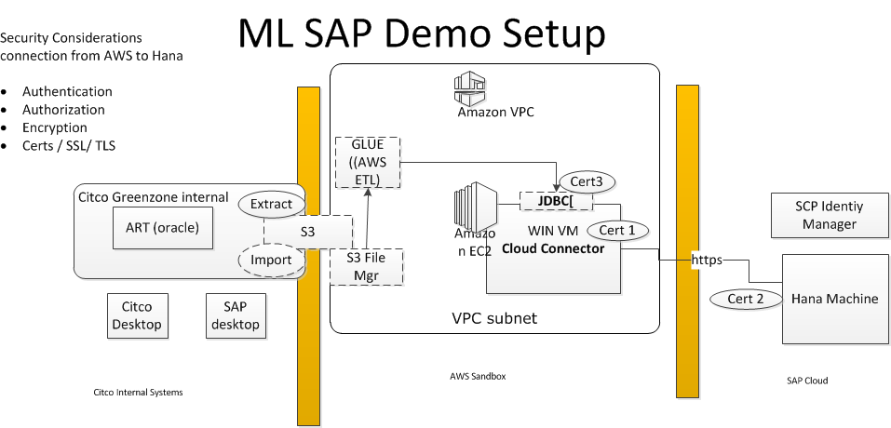
ML for High Volume Trading Reconsolidation
Customer Intensive
Leading Hedge Fund Manager
8,000
Employees
Key Technologies leveraged:
HANA Platform
Predictive Analytics
SAP Cloud Platform
ART – Automated Reconsolidation Tracking
PA
Perfect Match
Partial Matches
Not Matched
Executive Sponsors
CIO
MD of Trading Clearing
Non-Critical Path
Critical Path
Results / outcomes / next steps:
Delivered content and demos that
Showcased the machine learning (ML) capabilities
Showcased the traceability of the utilized ML logic
Technology scale and security matching customer needs
Solid project plan and methodology for implementation
Next: Ensure first ML models are developed, tested and adopted
Yellow indicated where customer wants to leverage SAP Machine Learning
Business Challenges and scope of collaborative prototype
The customer is a leader for financial services for institutional funds as well as large wealth (hedge, private equity and real-estate). The efficient execution of their changing investment strategies requires a complex reconsolidation platform. Despite their automated platform customer still requires about 1000 people to manage transactions that are not executed automated.
The customer wants to leverage the SAP Machine Learning to help automate reconciliations their current core platform can’t. SAP’s solution is differentiated in 2 key areas: The powerful and self-adaptable Machine Learning capabilities as well as the ability to ‘reverse engineer’ the machine learning logic to have full transparency upon the logic and principles on how the system decides and operates – a requirement both by internal stakeholders and trade regulations.
Notes:
The Citco case is far from unique. Within the financial sector, about 65% of all employments are back-office jobs, which handles all the cases, where their financial systems fall short.

Slide 4
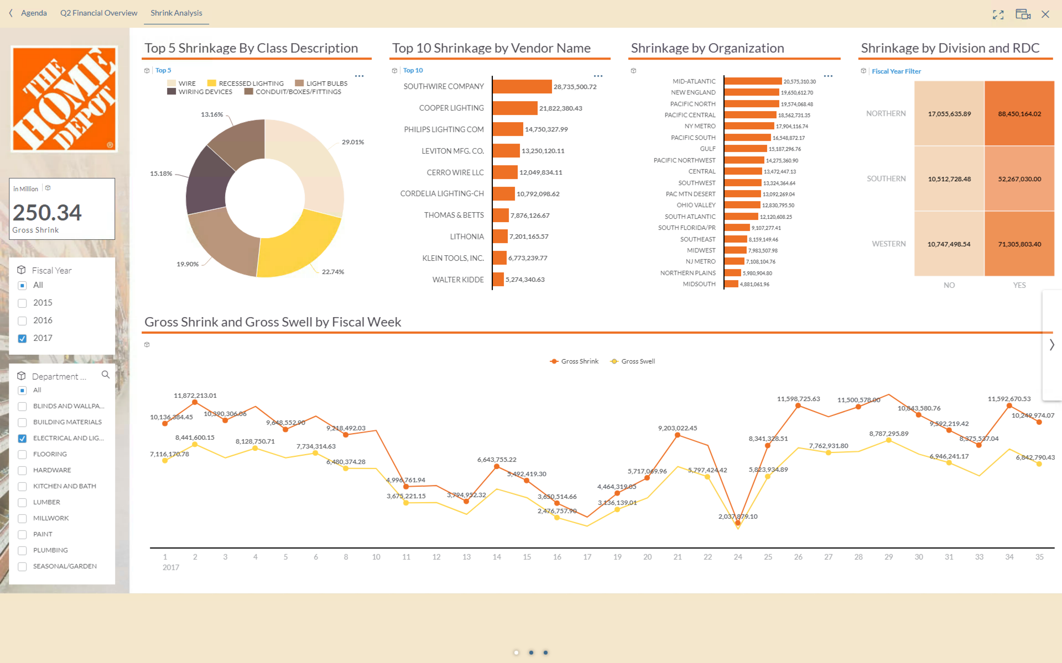
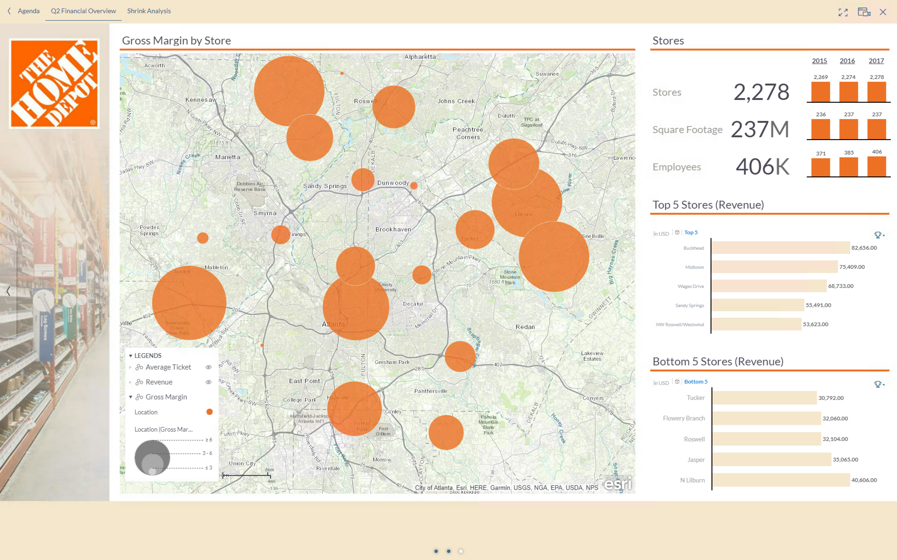
Shrink Cause Analysis from Administrative Data
$100 bn
Annual Revenue
500,000
employees
Key Technologies leveraged:
HANA Platform (Spatial, APL, ETL)
SAP Business Objects Data Services
Executive Sponsors
Director Finance IT
Sr. Manager Data Analytics
Results / outcomes / next steps:
Developed models that
Identified support variables and shrink drivers that can lead to actionable insights focused on shrink reduction
Discovered shrink cause due to RDC supply chain activity specifically sending DCs 2777 and 2837
Criminal activity specifically violent crimes, and property crimes can be an indicator of shrink increase
Next: second phase Poc proposal will be suggested to dig deeper into identifying what can be enhanced to decrease shrink
Business Challenges and scope of collaborative prototype
Shrink increased from $2B in 2016 to $2.2B in 2017 totaling 2% of revenue from 2016 to 2017. The customer is trying to understand the causes of increase by considering supply chain, ordering channels, and location data.
During the PoC, SAP enhanced the data with crime data from the FBI database and built a predictive model to detect the causes of shrink from provided administrative data. The factors considered affect only 12% of shrink causes, and not the remaining 88%.

